Slide 1
Mobile and robotic arm tasking using camera and LIDAR
2022/05/20
Wataru Oshima

Slide 2
Agenda
The content of this project
The experimental video
The System architecture
The hardware and software requirement
The environmental setting
LiDAR Threshold (2D)
LiDAR Threshold (3D)
Technical detail

Slide 3
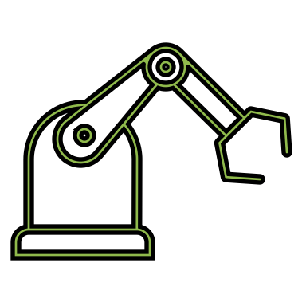

I. The content of this project
Place an object on the mobile robot and run it on the line by following the center of mass.
Once it detects an obstacle(QR code for Optimal), it stops and sends a signal to the arm ronbot to pick up the object.
When the arm robot receives the signal, the realsense camera placed at the top of the arm robot starts to detect the coordinate of the center of mass of the object and send it to the arm robot.
After the arm robot receives the coordinate from the camera, it converts the cooridante to the rbot coordinate by multiplying with the callibrated coefficients, and start to pick up the object.

Slide 4
II. The experiment video
Please refer to the other file

Slide 5
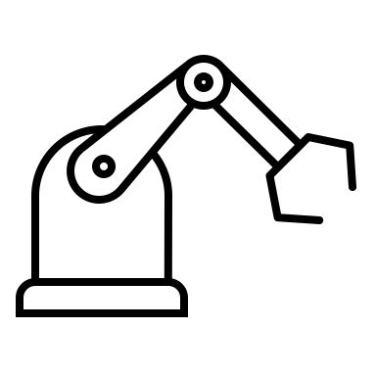

III. The system architecture
limo-wifi
Roscore
Line_trace
QR_detector
mask_detector
MG400_work_automatic

Slide 6
IV. The hardware and software requirement
Hardware
Jetson nano 2gb x2
Mobile robot x1
Arm robot x1
LiDAR x1
2D stereo camera x1
RGB-D camera x1
colored tape x1
wifi dongle x3
Software (all based on ROS:melodic)
Common pkgs
OPENCV 4 （CUDA）
camera_pkg
For the arm robot
MG400_basic
MG400_ROS
For the mobile robot
limo_ros
vision_visp

Slide 7
V. The environmental setting
Detecting lines
Detectingan objects and measuring the distancce
Measuring the distance to obstacles
RGB-D camera
Stereo camera
LiDAR
Jetson nano 2gb on Arm robot
Jetson nano 2gb(4gb) on Mobile Robot
Communucating through wifi ( should be int the same network)

Slide 8


VI. LiDAR Threshold (2D)
I set the angle ±20° so that it can detect an obstacle with in the range. The false negative detection is less likely to happen within the range because I gather all the data within the range and pick up the minimum value so that the mobile robot can avoid colliding an obstacle. However, because of the specification of LiDAR, the sensor does not measure a distance less than 10 cm. So I could say that if some objects suddenly appear less than 10 cm, the robot is most likely not to perceive it.
To decrease the rate of the false positive detection, I set a vector to store the value from the lidar sensor. If the detected distance from the sensor is less than 50cm, then the velocity is 2 times slower than the usual speed so that the sensor can get more accurate data. And if the distance is less than 35 cm, then the size of vector increase by 1 and if the size of vector is 5 then , finally the robot stops.
40°
40°
50cm ~
35 ~ 50cm
10~ 35cm
~10cm
Mobile Robot

Slide 9
VII. LiDAR Threshold (3D)
For 3D obstacle detection, since the lidar sensro is capable of detectin only 2 Dimension, the false positve detection is almost 100 % when the height of object is less than 10 cm. However, the height of object is more than 10 cm, we do not have to think about the false positive detection.
Mobile Robot
~10cm

Slide 10
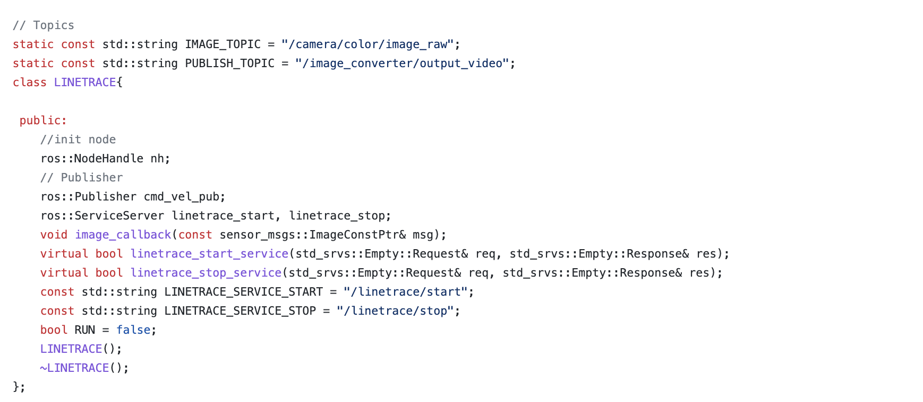
VIII. Technical detail(Line detection)
Creating rossevices so that the operator can start/stop the line follwoing anytime

Slide 11
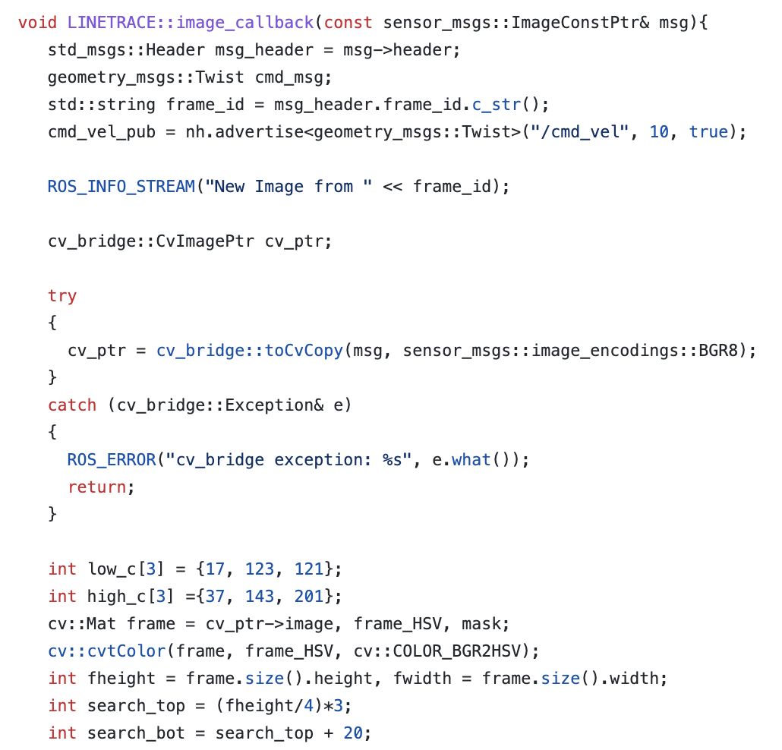
VIII. Technical detail(Line detection)
For masking. the parameters are set for yellow, but you can change them to any color you want them to detect.

Slide 12
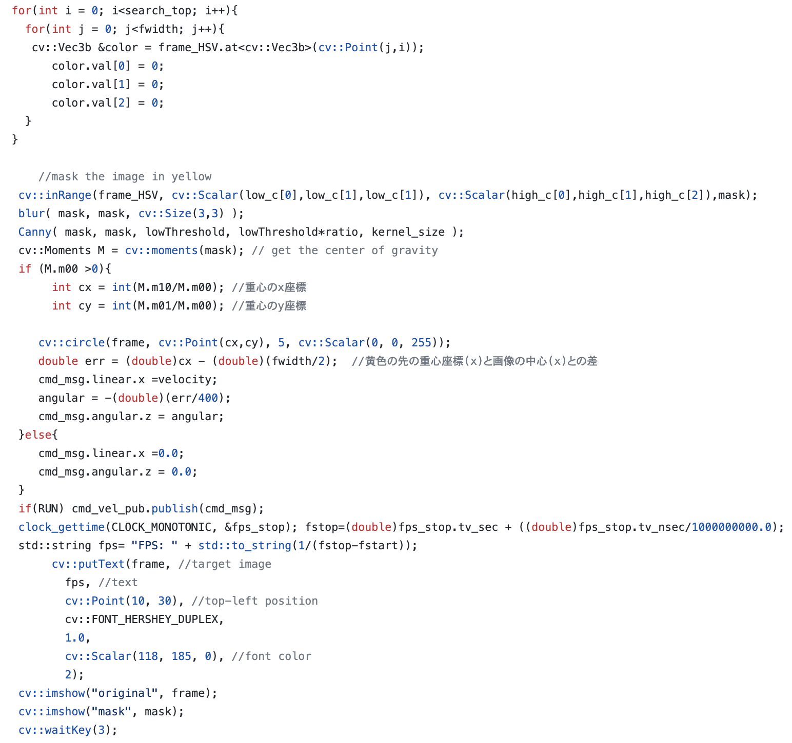
VIII. Technical detail(Line detection)
Except for the ROI, it fill-in black so that the rate of false positive can reduces
To decrease the rate of false postive detection, after masking an image, use blur to erase noise and canny for edge detection
If two or one lines are detected, then it takes the center of mass and followes it. Besides that, I tune it by p- control so that the mobile robot can make a turn smoothly
Show FPS

Slide 13
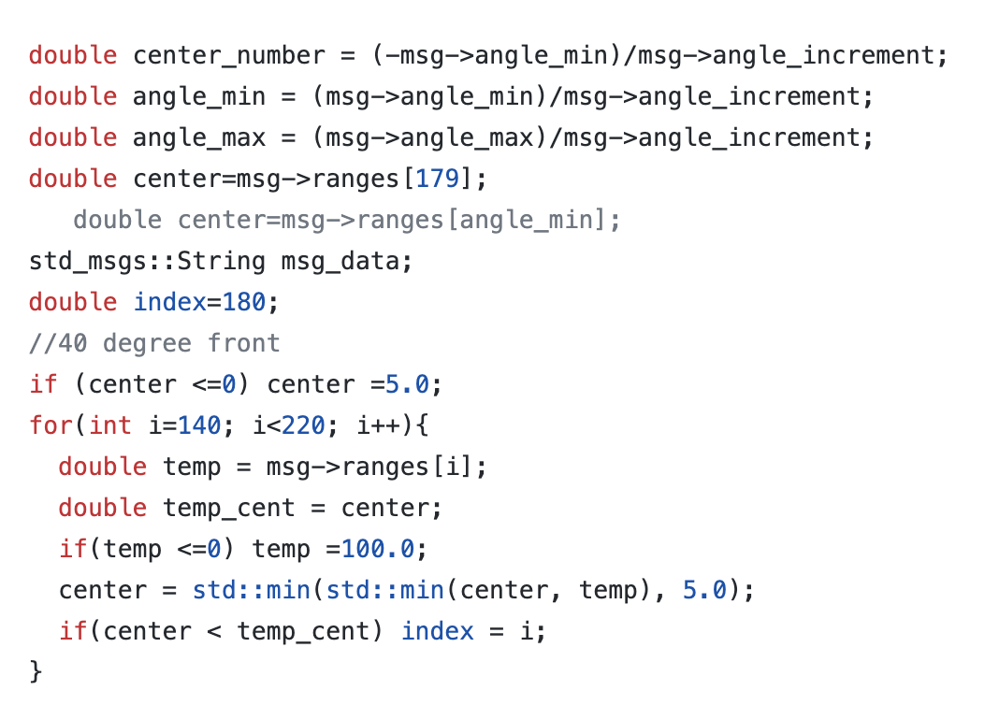
VIII. Technical detail(Line detection)
Checking the front by gathering the scan info from LiDAR sensor
If the distance is a negative number, then it sets the distance 100.

Slide 14
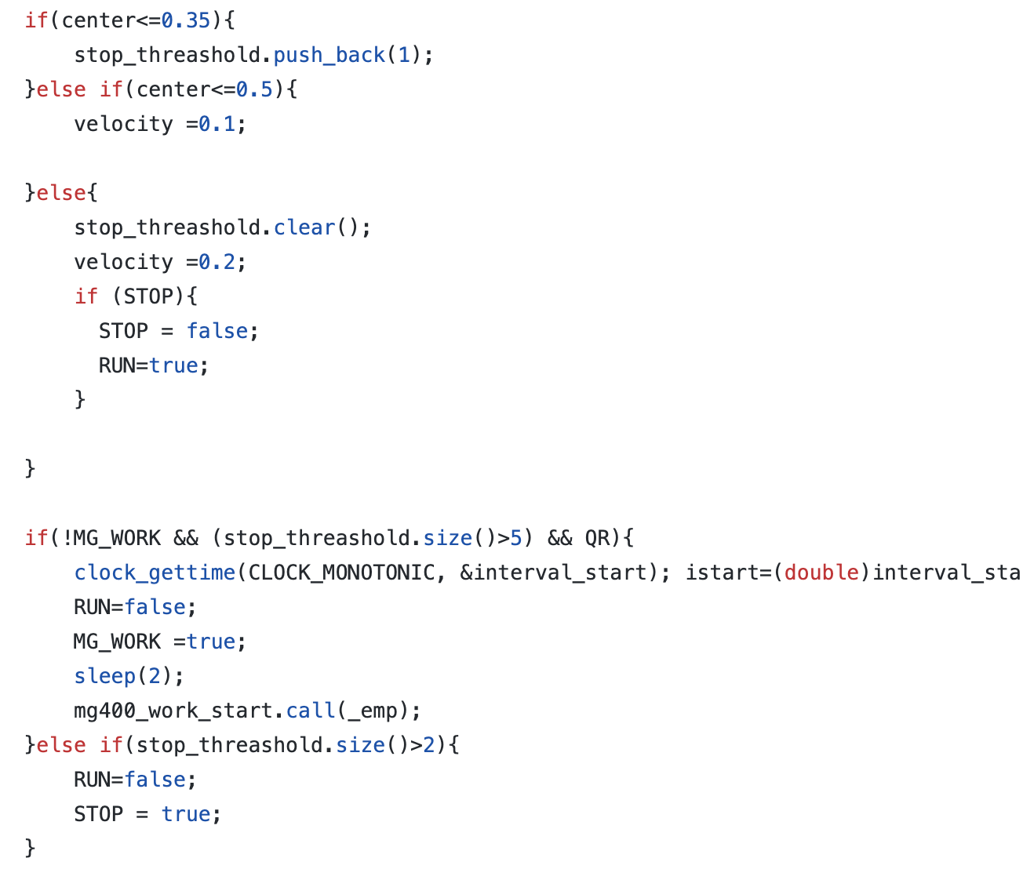
VIII. Technical detail(Line detection)
If it is within 50 cm, then it slows down and within 35 cm it stops.
If QR code is detected, then it regards the obstacle as a pick-up point. Otherwise, it just stops.
After it stops, then it call the rosservice to start the pickup.

Slide 15
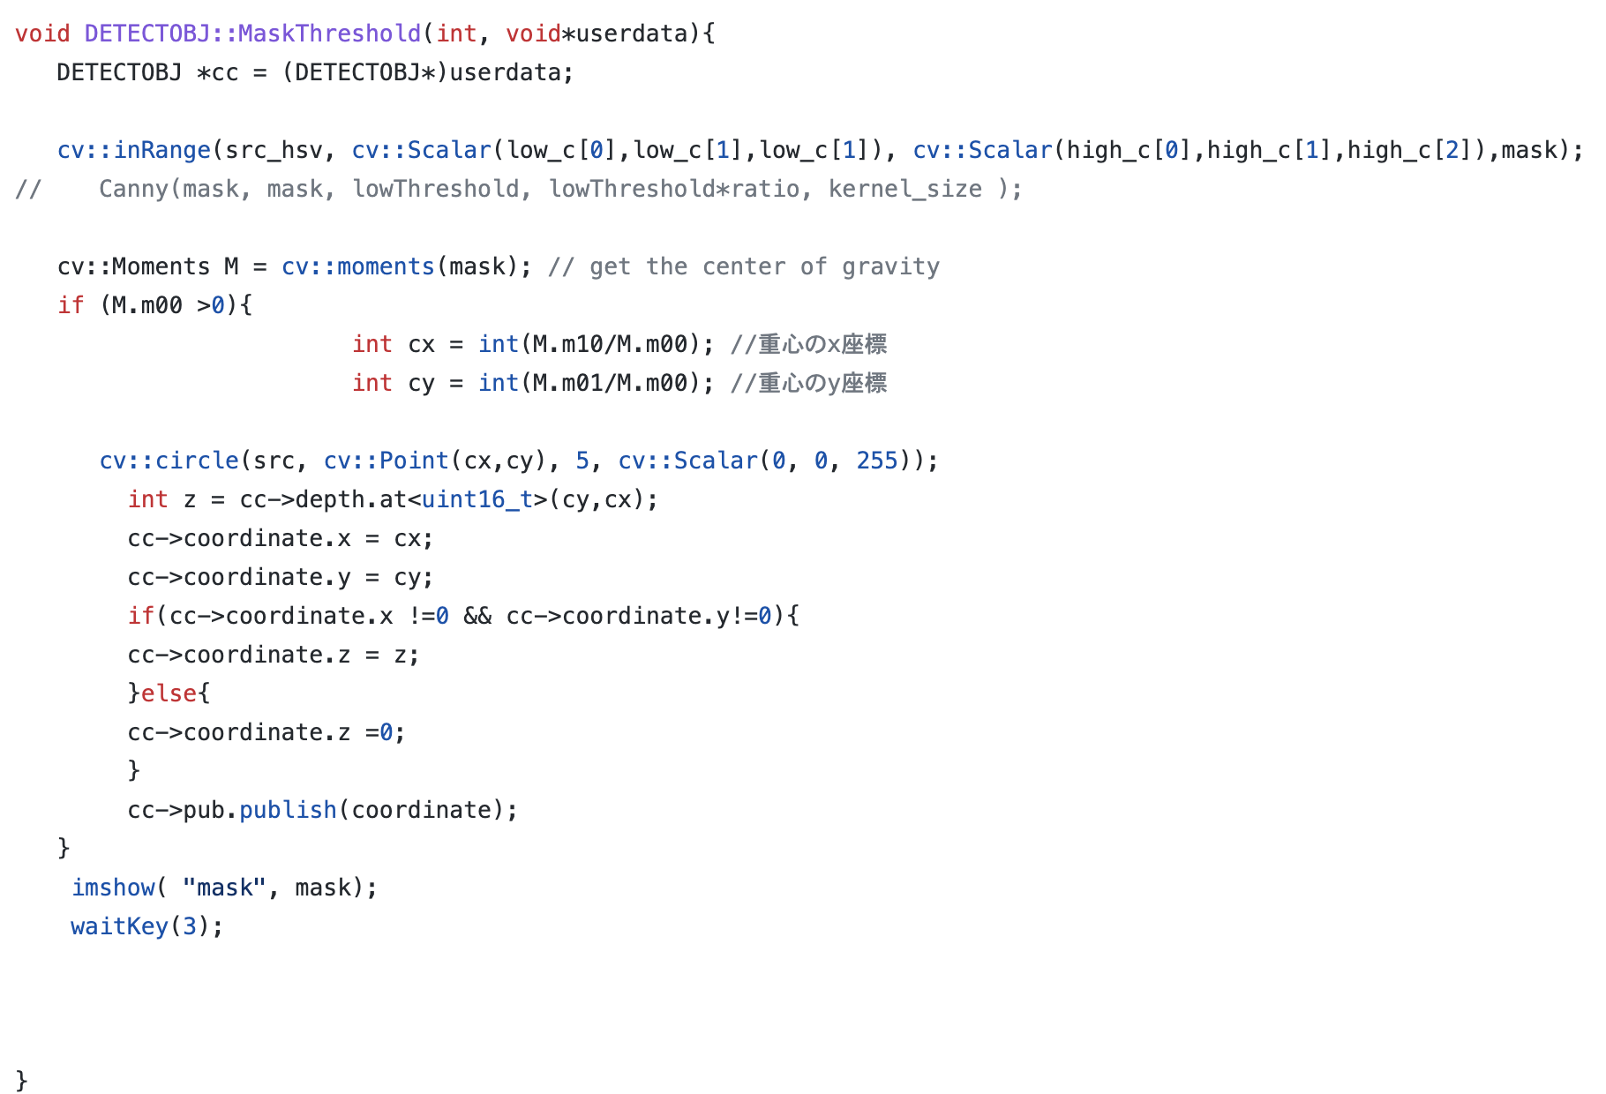
VIII. Technical detail(mask detector)
I use the function of detecting the center of mass here as well which is also used in line detection.

Slide 16
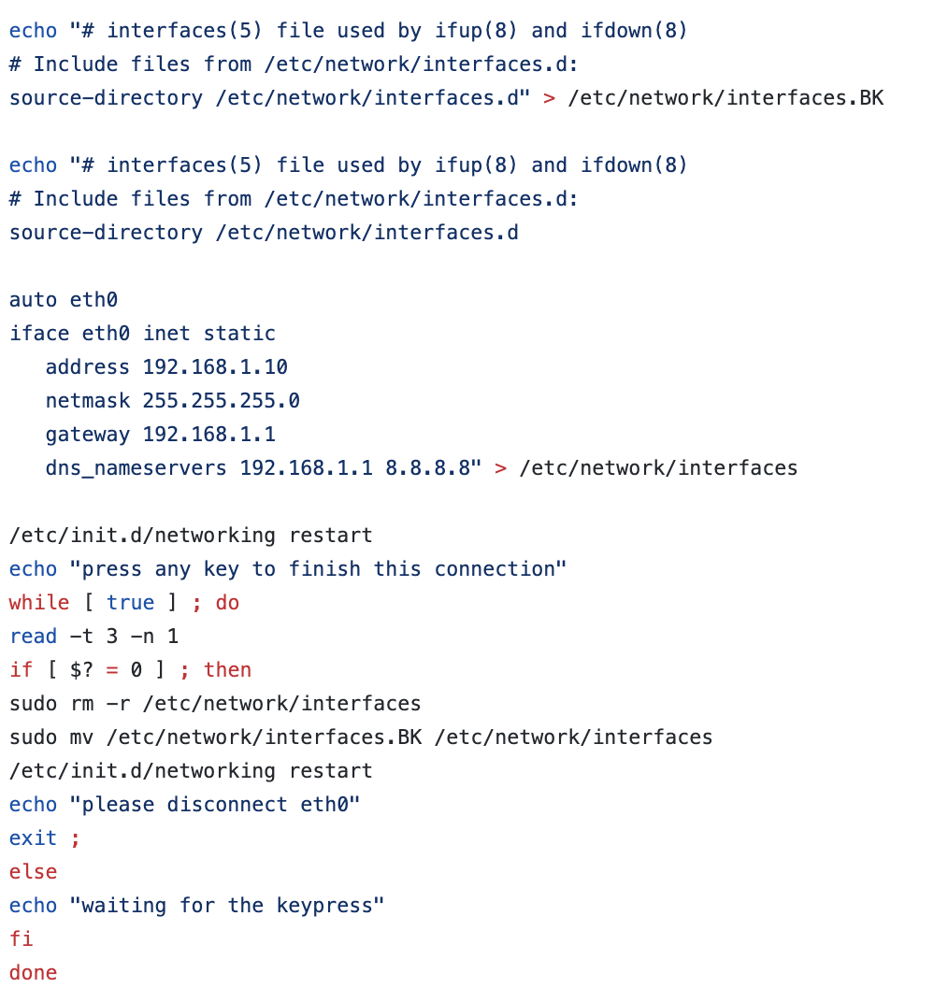
VIII. Technical detail(MG400 connection)
For connection to the arm robot (bash file)

Slide 17
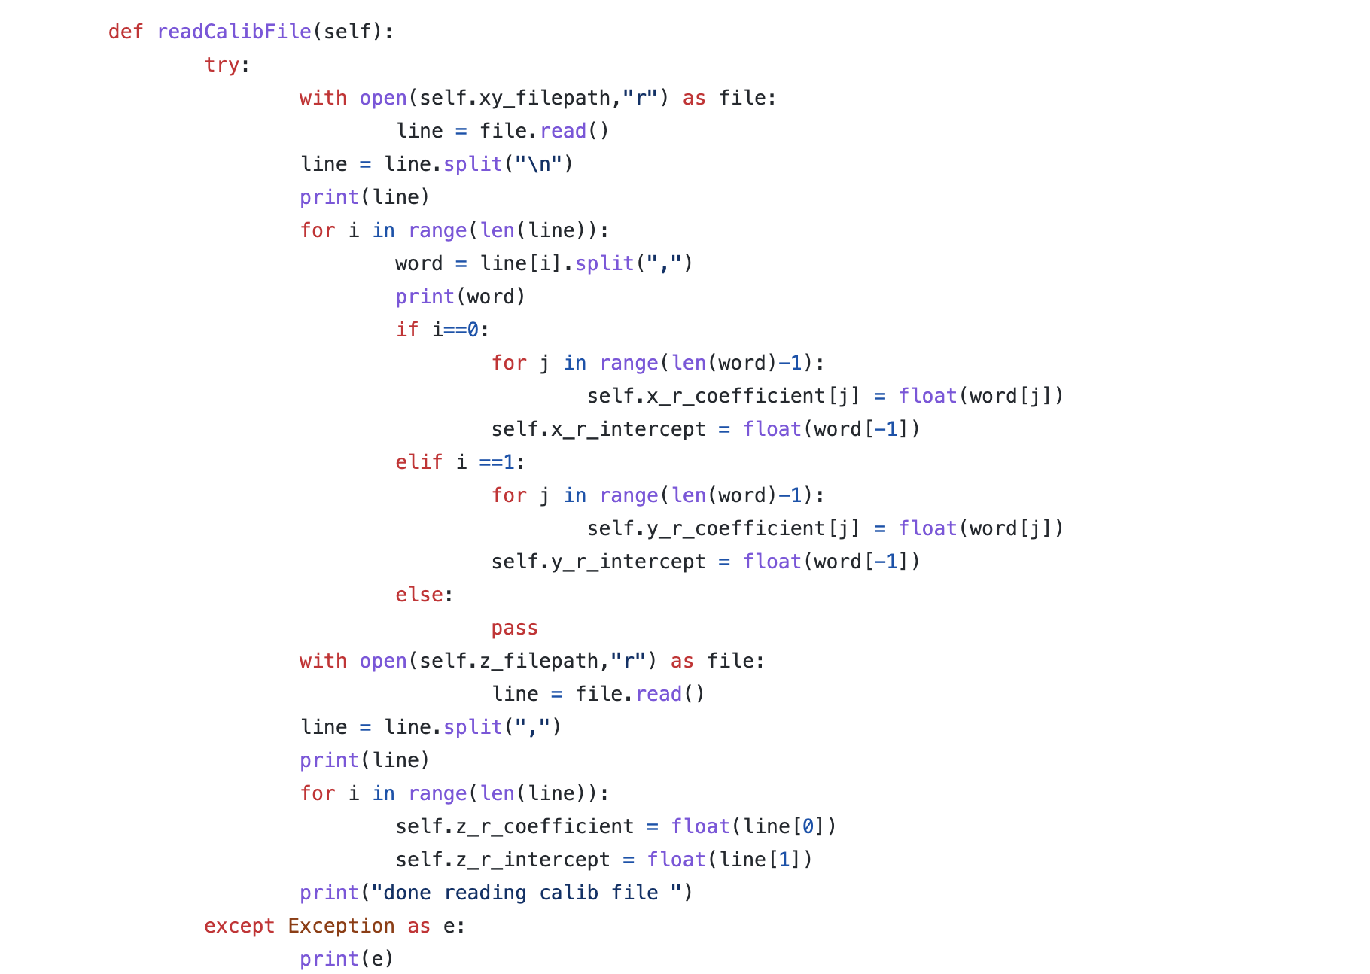
VIII. Technical detail(MG400_work_automatic)
Reading the callibration file (xy and z coordination are separated)

Slide 18
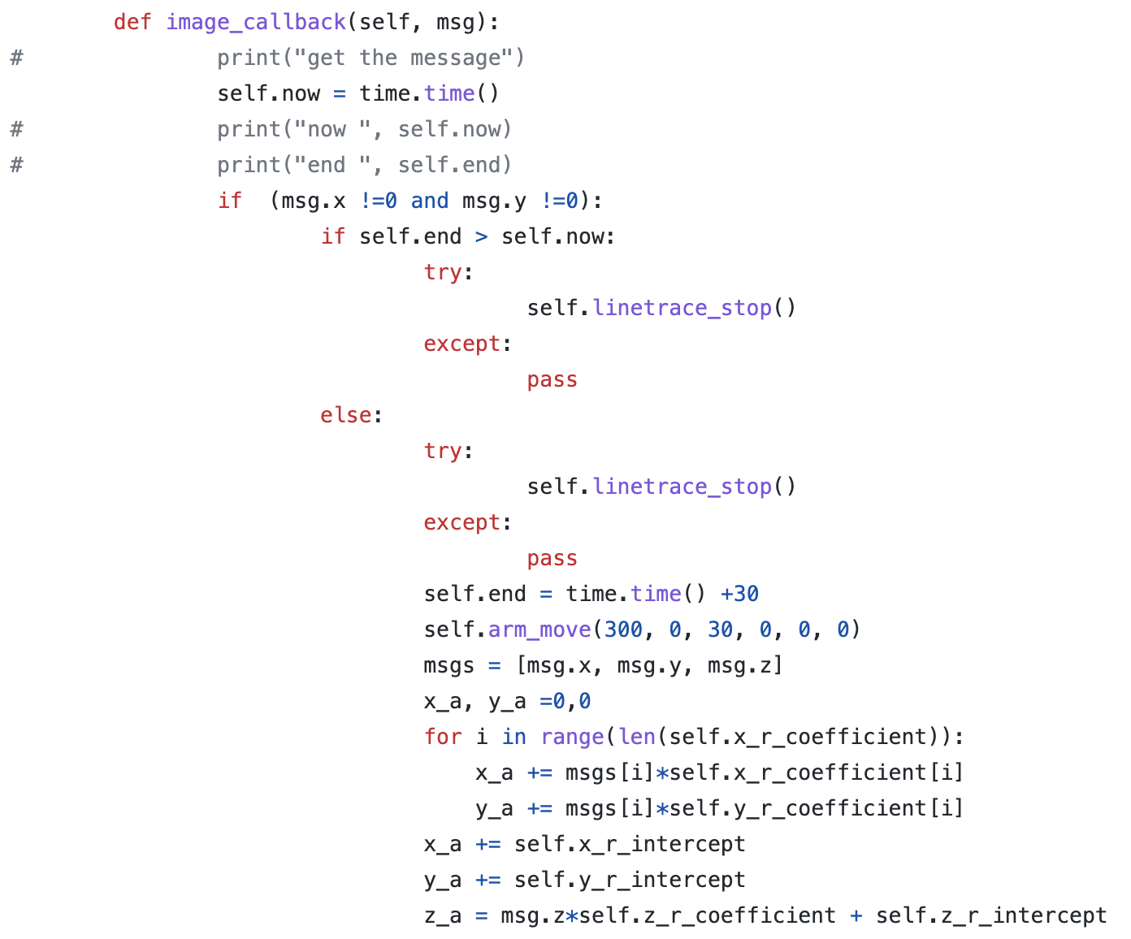
VIII. Technical detail(MG400_work_automatic)
ignoring the ros topic for 30 seconds
Plug in the coefficients from the calibration file

Slide 19
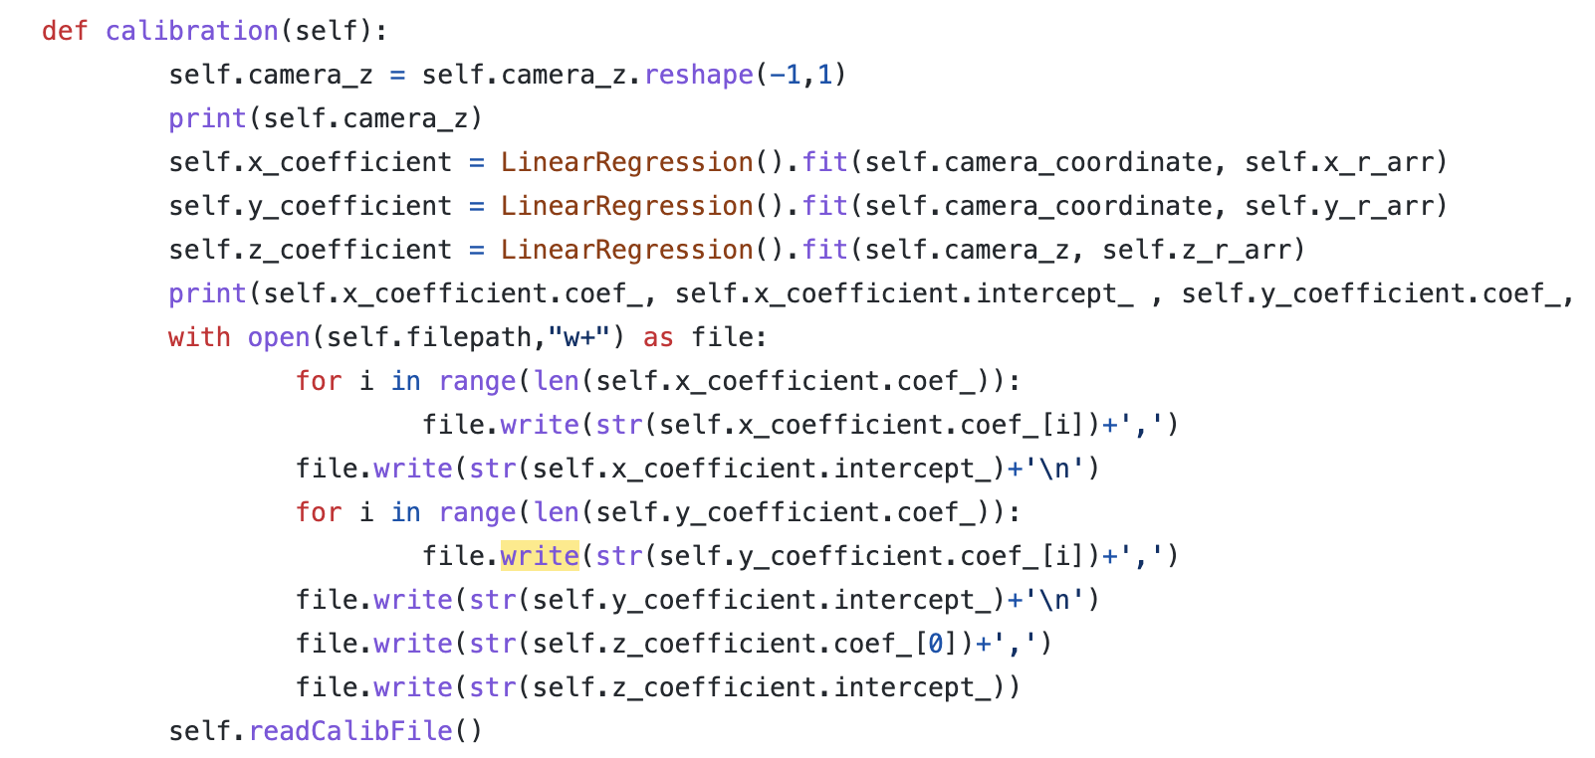
VIII. Technical detail(MG400_work_automatic)
Linear regression for coordinate callibration

